Slide 1
Narrative Part 1 basic structures & Hero journey
HOPE CATON
CI7870 Game Design 16 October 2019

Slide 2
Story basics
The beginning
The middle – the change, the happening
The end.

Slide 3
Why do we tell stories?
Stories are recognizable patterns, and in those patterns we find meaning.
We use stories to make sense of our world and to share that understanding with others.
They are the signal within the noise.
So powerful is our impulse to detect story patterns that we see them even when they're not there.
Wired Magazine 8 Mar 2011

Slide 4
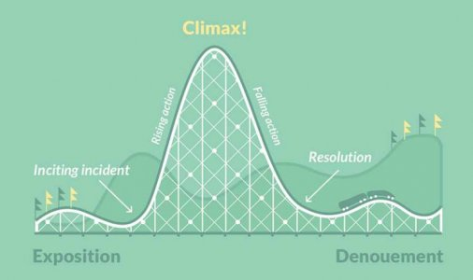

Slide 5
The plot

Slide 6
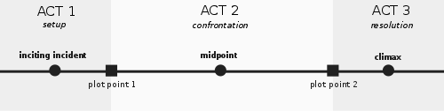
3-Act screenplay structure

Slide 7
Act 1
World as it is
Call to adventure
Inciting incident
Consequences of incident
Decision to proceed
Boy meets girl

Slide 8
Act 2 - 1
Another world
Backstory
Building conflict
Introduce complication
Introduce mentor or love interest
Boy loses girl

Slide 9
Act 2 - 2
World collapsing
Inner struggle, violence, capture
Insurmountable conflict
All is lost moment
Death of mentor or love interest
Resolve to continue
Boy loses girl

Slide 10
Act 3
Final push to climax
Gathering of resources
Big boss battle
Death of enemies,
Or resolution of quarrel
Return with elixir
Some connection to the beginning, but changed
Boy gets girl

Slide 11
Character

Slide 12
The Hero’s Journey
The Hero with a Thousand Faces, Joseph Campbell
https://www.youtube.com/watch?v=6eNun-x_s2Y
The Hero’s Journey Teacher’s edition
“The Cave you Fear to enter holds the treasure you seek” Joseph Campbell

Slide 13
Writing compelling characters
CHARACTER DIAMOND
Persona
Greatest strength
Biggest weakness
Best self
Different characters suit different style plots

